Slide 1
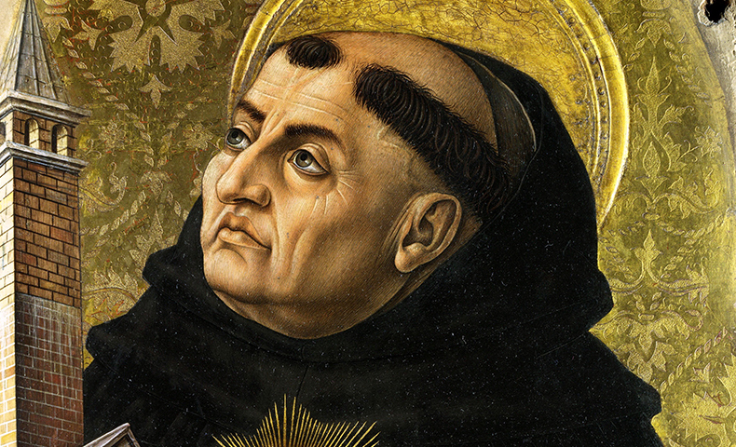
Introduction to Philosophy
Aquinas The Five Ways

Slide 2
Introduction to Philosophy
Aquinas The Five Ways
Saint Thomas Aquinas
1225-1274
Italian
Dominican friar
natural theology
Aristotle/Christianity

Slide 3
Introduction to Philosophy
Aquinas The Five Ways
The three main types of arguments for the existence of God:
cosmological (“first cause”)
the bare fact that there is a universe, that things exist
teleological (”design”)
the fact that many things in the universe have purpose or order
ontological
the idea/definition of “God”

Slide 4
Introduction to Philosophy
Aquinas The Five Ways
The Second Way: Argument from Efficient Causes
Premise Nothing exists without efficient cause
Premise Nothing is the efficient cause of itself
Premise You can’t trace back the efficient cause idefinitely
Premise There must be an originator of the first cause
Conclusion God exists as the first originator

Slide 5
Introduction to Philosophy
Aquinas The Five Ways
The Second Way: Argument from Efficient Causes
In the natural world (i.e the world of physical objects in space and time), events occur. (an event = thing(s) undergoing change).
Every natural event has a cause.
Since a cause must exist before its effect, nothing can be its own cause, because nothing can exist before it exists.
A chain of causes and effects extending into the past to infinity is an impossibility.
---------
5. There is a first uncaused cause of the first natural event(s) (the Big Bang?), which is not itself a natural event or natural thing.
---------
6. This “supernatural” thing is God.

Slide 6
Introduction to Philosophy
Aquinas The Five Ways
The Second Way: Argument from Efficient Causes
In the natural world (i.e the world of physical objects in space and time), events occur. (an event = thing(s) undergoing change).
Every natural event has a cause.
Since a cause must exist before its effect, nothing can be its own cause, because nothing can exist before it exists.
A chain of causes and effects extending into the past to infinity is an impossibility.
---------
5. There is a first uncaused cause of the first natural event(s) (the Big Bang?), which is not itself a natural event or natural thing.
---------
6. This “supernatural” thing is God.
Objection 1: 6 doesn’t follow from 5.

Slide 7
Introduction to Philosophy
Aquinas The Five Ways
The Second Way: Argument from Efficient Causes
In the natural world (i.e the world of physical objects in space and time), events occur. (an event = thing(s) undergoing change).
Every natural event has a cause.
Since a cause must exist before its effect, nothing can be its own cause, because nothing can exist before it exists.
A chain of causes and effects extending into the past to infinity is an impossibility.
---------
5. There is a first uncaused cause of the first natural event(s) (the Big Bang?), which is not itself a natural event or natural thing.
---------
6. This “supernatural” thing is God.
Objection 2: 4 is not obviously true.

Slide 8
Introduction to Philosophy
Aquinas The Five Ways
The Second Way: Argument from Efficient Causes
In the natural world (i.e the world of physical objects in space and time), events occur. (an event = thing(s) undergoing change).
Every natural event has a cause.
Since a cause must exist before its effect, nothing can be its own cause, because nothing can exist before it exists.
A chain of causes and effects extending into the past to infinity is an impossibility.
---------
5. There is a first uncaused cause of the first natural event(s) (the Big Bang?), which is not itself a natural event or natural thing.
---------
6. This “supernatural” thing is God.
Objection 3: “Every natural event” instead of “Everything” in 2 has to be justified.

Slide 9
Introduction to Philosophy
Aquinas The Five Ways
The Second Way: Argument from Efficient Causes
In the natural world (i.e the world of physical objects in space and time), events occur. (an event = thing(s) undergoing change).
Every natural event has a cause.
Since a cause must exist before its effect, nothing can be its own cause, because nothing can exist before it exists.
A chain of causes and effects extending into the past to infinity is an impossibility.
---------
5. There is a first uncaused cause of the first natural event(s) (the Big Bang?), which is not itself a natural event or natural thing.
---------
6. This “supernatural” thing is God.
Objection 4: The inference from 1-4 to 5 commits the “birthday fallacy.”

Slide 10
Introduction to Philosophy
Aquinas The Five Ways
© 2016 Theodore Gracyk
The First Way: Argument from Motion
Premise
Premise
Premise
Conclusion

Slide 11
Introduction to Philosophy
Aquinas The Five Ways
© 2016 Theodore Gracyk
The First Way: Argument from Motion
Our senses prove that some things are in motion.
Things move when potential motion becomes actual motion.
Only an actual motion can convert a potential motion into an actual motion.
Nothing can be at once in both actuality and potentiality in the same respect (i.e., if both actual and potential, it is actual in one respect and potential in another).
Therefore nothing can move itself.
Therefore each thing in motion is moved by something else.
The sequence of motion cannot extend ad infinitum.
Conclusion: Therefore it is necessary to arrive at a first mover, put in motion by no other; and this everyone understands to be God.

Slide 12
Introduction to Philosophy
Aquinas The Five Ways
© 2016 Theodore Gracyk
The Third Way: Argument from Possibility and Necessity (Reductio argument)
Premise
Premise
Premise
Conclusion

Slide 13
Introduction to Philosophy
Aquinas The Five Ways
© 2016 Theodore Gracyk
The Third Way: Argument from Possibility and Necessity (Reductio argument)
We find in nature things that are possible to be and not to be, that come into being and go out of being i.e., contingent beings.
Assume that every being is a contingent being.
For each contingent being, there is a time it does not exist.
Therefore it is impossible for these always to exist.
Therefore there could have been a time when no things existed.
Therefore at that time there would have been nothing to bring the currently existing contingent beings into existence.
Therefore, nothing would be in existence now.
We have reached an absurd result from assuming that every being is a contingent being.
Therefore not every being is a contingent being.
Conclusion: Therefore some being exists of its own necessity, and does not receive its existence from another being, but rather causes them. This all men speak of as God.

Slide 14
Introduction to Philosophy
Aquinas The Five Ways
© 2016 Theodore Gracyk
The Fourth Way: Argument from Gradation of Being
Premise
Premise
Premise
Conclusion

Slide 15
Introduction to Philosophy
Aquinas The Five Ways
© 2016 Theodore Gracyk
The Fourth Way: Argument from Gradation of Being
There is a gradation to be found in things: some are better or worse than others.
Predications of degree require reference to the “uttermost” case (e.g., a thing is said to be hotter according as it more nearly resembles that which is hottest).
The maximum in any genus is the cause of all in that genus.
Conclusion: Therefore there must also be something which is to all beings the cause of their being, goodness, and every other perfection; and this we call God.

Slide 16
Introduction to Philosophy
Aquinas The Five Ways
© 2016 Theodore Gracyk
The Fifth Way: Argument from Design
Premise
Premise
Premise
Conclusion

Slide 17
Introduction to Philosophy
Aquinas The Five Ways
© 2016 Theodore Gracyk
The Fifth Way: Argument from Design
We see that natural bodies work toward some goal, and do not do so by chance.
Most natural things lack knowledge.
But as an arrow reaches its target because it is directed by an archer, what lacks intelligence achieves goals by being directed by something intelligent.
Conclusion: Therefore some intelligent being exists by whom all natural things are directed to their end; and this being we call God.

